Slide 1
Help Wanted Online A real-time measure of job postings
September 2022
Office of Research Connecticut Department of Labor
Connecticut Department of Labor – Research Office 200 Folly Brook Blvd. Wethersfield, CT 06109
Help Wanted Online

Slide 2
What is HWOL?
The Conference Board Help Wanted Online® Data Series (HWOL) measures the number of new, first-time Online job postings and jobs reposted from the previous month for over 50,000 Internet job boards, corporate boards and smaller job sites that serve niche markets and smaller geographic areas.
Connecticut Department of Labor – Research Office 200 Folly Brook Blvd. Wethersfield, CT 06109
Help Wanted Online

Slide 3
Note on a Recent Data Revision
The HWOL data series was revised last month to address a change in job posting behavior at a large job board. The revision resulted in a total posting count drop from what was previously observed from May 2022 through August 20th, 2022. This document contains job posting counts extracted after this revision for the week ending September 3rd and the month of August 2022.
Connecticut Department of Labor – Research Office 200 Folly Brook Blvd. Wethersfield, CT 06109
Help Wanted Online

Slide 4
Upcoming Release Dates
Monthly Report: Friday, October 14th, 2022 Weekly New Ads Report: Updated every Friday
Connecticut Department of Labor – Research Office 200 Folly Brook Blvd. Wethersfield, CT 06109
Help Wanted Online

Slide 5
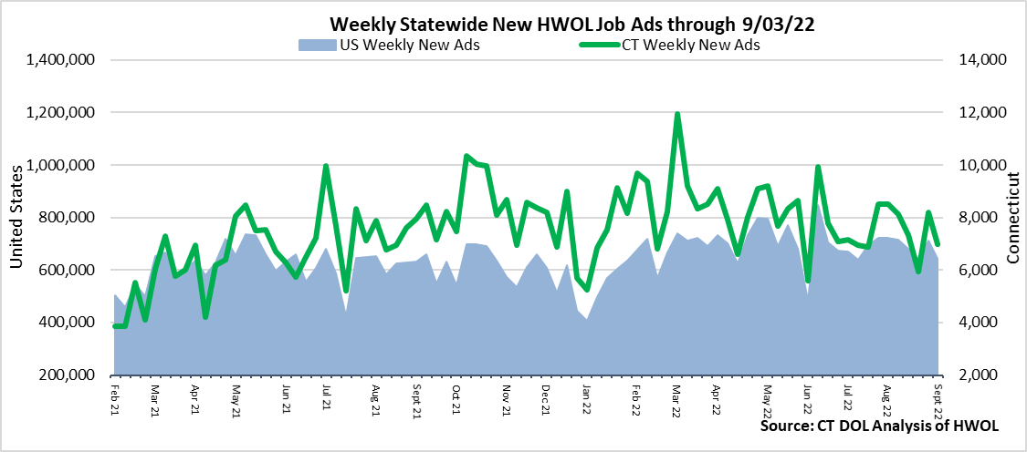
Statewide Weekly New Job Ads
Weekly New job postings was 6,988 during the week ending 9/03/22.
Connecticut Department of Labor – Research Office 200 Folly Brook Blvd. Wethersfield, CT 06109
Help Wanted Online

Slide 6
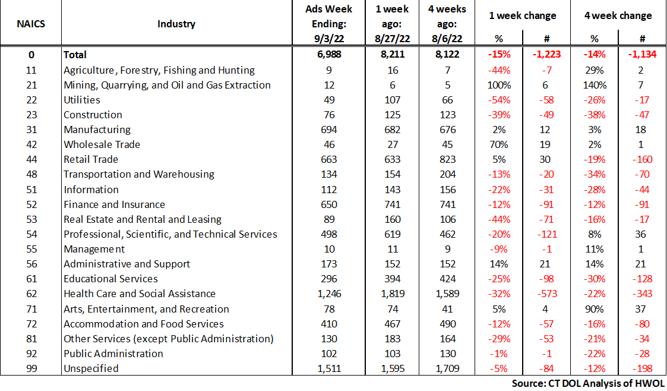
HWOL New Weekly Industry Job Ads – CT Statewide
Connecticut Department of Labor – Research Office 200 Folly Brook Blvd. Wethersfield, CT 06109
Help Wanted Online

Slide 7
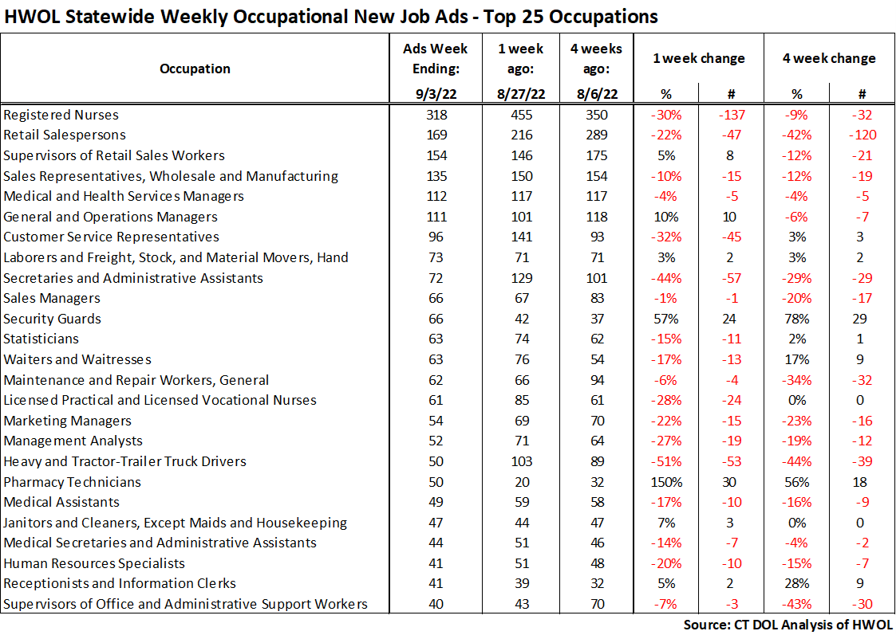
Connecticut Department of Labor – Research Office 200 Folly Brook Blvd. Wethersfield, CT 06109
Help Wanted Online

Slide 8
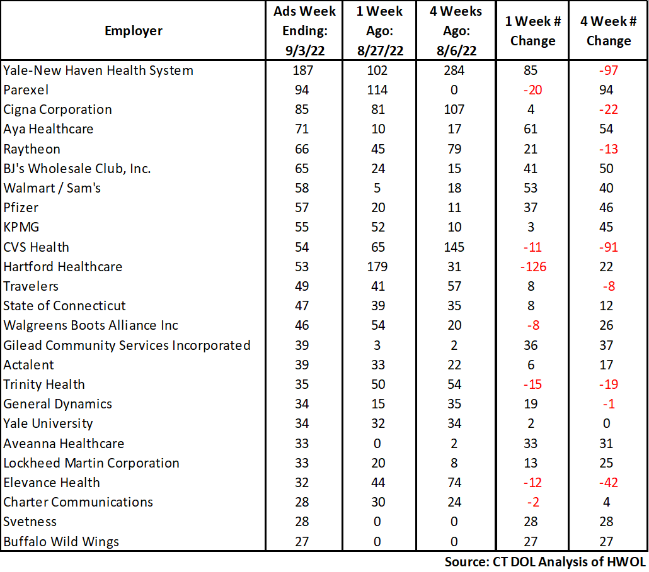
Employers with the Most New Job Postings
Connecticut Department of Labor – Research Office 200 Folly Brook Blvd. Wethersfield, CT 06109
Help Wanted Online

Slide 9
Monthly HWOL Information
The following pages contain HWOL monthly data for August 2022 Monthly and weekly job ad information can be found here: https://www1.ctdol.state.ct.us/lmi/HWOL.asp
Connecticut Department of Labor – Research Office 200 Folly Brook Blvd. Wethersfield, CT 06109
Help Wanted Online

Slide 10
Statewide Highlights
- Total postings in Connecticut was 90,482 in August 2022, down 5% from July 2022. -Industry sectors with the most job postings were Health Care and Social Assistance (17,883 postings), Retail Trade (8,532 posting), Manufacturing (8,401 postings), and Finance & Insurance (8,236 postings).
-Occupations with the most postings were Registered Nurses (5,548 postings), Retail Salespersons (3,321 postings), Supervisors of Retail Sales Workers (2,860 postings), and Wholesale and Manufacturing Sales Representatives (2,559).
Connecticut Department of Labor – Research Office 200 Folly Brook Blvd. Wethersfield, CT 06109
Help Wanted Online

Slide 11
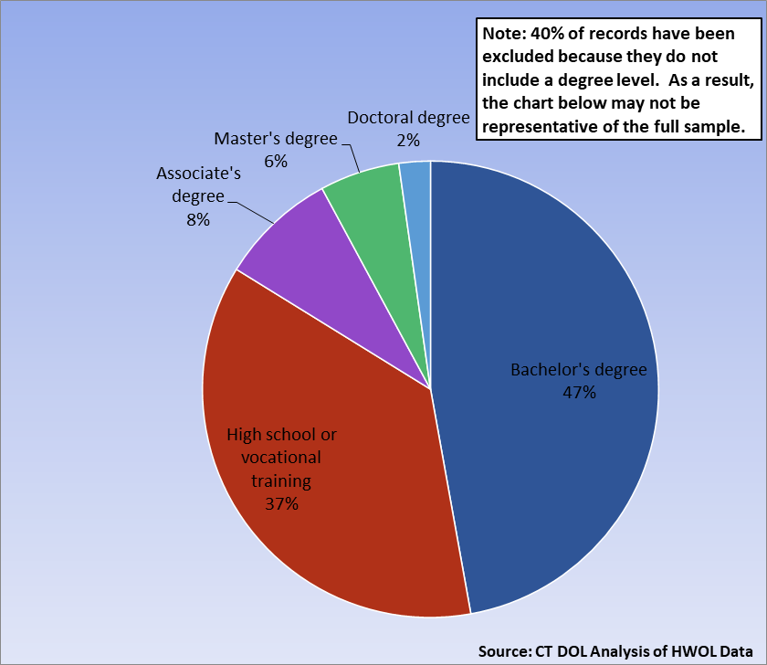
Connecticut Job Ads by Educational Requirements
Connecticut Department of Labor – Research Office 200 Folly Brook Blvd. Wethersfield, CT 06109
Help Wanted Online

Slide 12
Top Certifications in Connecticut Job Ads
Connecticut Department of Labor – Research Office 200 Folly Brook Blvd. Wethersfield, CT 06109
Help Wanted Online

Slide 13
Top Skills in Connecticut Job Ads
Connecticut Department of Labor – Research Office 200 Folly Brook Blvd. Wethersfield, CT 06109
Help Wanted Online

Slide 14
Top Skills by Industry in Connecticut Job Ads
Connecticut Department of Labor – Research Office 200 Folly Brook Blvd. Wethersfield, CT 06109
Help Wanted Online

Slide 15
Top Skills by Industry in Connecticut Job Ads (Continued)
Connecticut Department of Labor – Research Office 200 Folly Brook Blvd. Wethersfield, CT 06109
Help Wanted Online

Slide 16
Connecticut Department of Labor – Research Office 200 Folly Brook Blvd. Wethersfield, CT 06109
Help Wanted Online

Slide 17
Connecticut Employers with the Most Job Ads
Connecticut Department of Labor – Research Office 200 Folly Brook Blvd. Wethersfield, CT 06109
Help Wanted Online

Slide 18
Connecticut Occupations with the Most Job Ads
Connecticut Department of Labor – Research Office 200 Folly Brook Blvd. Wethersfield, CT 06109
Help Wanted Online

Slide 19
Connecticut Job Ads by Industry and Major Occupational Group
Connecticut Department of Labor – Research Office 200 Folly Brook Blvd. Wethersfield, CT 06109
Help Wanted Online

Slide 20
Workforce Area Data
Workforce Area Highlights
Job Ads by Industry
Job Ads by Location
Employers With The Most Job Ads
Occupations With The Most Job Ads
Connecticut Department of Labor – Research Office 200 Folly Brook Blvd. Wethersfield, CT 06109
Help Wanted Online

Slide 21
Workforce Area Highlights
Connecticut Department of Labor – Research Office 200 Folly Brook Blvd. Wethersfield, CT 06109
Help Wanted Online

Slide 22
Connecticut Department of Labor – Research Office 200 Folly Brook Blvd. Wethersfield, CT 06109
Help Wanted Online

Slide 23
Eastern Workforce Job Ads by Location
Connecticut Department of Labor – Research Office 200 Folly Brook Blvd. Wethersfield, CT 06109
Help Wanted Online

Slide 24
Eastern Workforce Employers
with the Most Job Ads
Connecticut Department of Labor – Research Office 200 Folly Brook Blvd. Wethersfield, CT 06109
Help Wanted Online

Slide 25
Eastern Workforce Occupations
with the Most Job Ads
Connecticut Department of Labor – Research Office 200 Folly Brook Blvd. Wethersfield, CT 06109
Help Wanted Online

Slide 26
Connecticut Department of Labor – Research Office 200 Folly Brook Blvd. Wethersfield, CT 06109
Help Wanted Online
26

Slide 27
North Central WDA Job Ads by Location
Connecticut Department of Labor – Research Office 200 Folly Brook Blvd. Wethersfield, CT 06109
Help Wanted Online

Slide 28
North Central WDA Employers
with the Most Job Ads
Connecticut Department of Labor – Research Office 200 Folly Brook Blvd. Wethersfield, CT 06109
Help Wanted Online

Slide 29
North Central WDA Occupations
with the Most Job Ads
Connecticut Department of Labor – Research Office 200 Folly Brook Blvd. Wethersfield, CT 06109
Help Wanted Online

Slide 30
Connecticut Department of Labor – Research Office 200 Folly Brook Blvd. Wethersfield, CT 06109
Help Wanted Online

Slide 31
Northwest WDA Job Ads by Location
Connecticut Department of Labor – Research Office 200 Folly Brook Blvd. Wethersfield, CT 06109
Help Wanted Online

Slide 32
Northwest WDA Employers
with the Most Job Ads
Connecticut Department of Labor – Research Office 200 Folly Brook Blvd. Wethersfield, CT 06109
Help Wanted Online

Slide 33
Northwest WDA Occupations
with the Most Job Ads
Connecticut Department of Labor – Research Office 200 Folly Brook Blvd. Wethersfield, CT 06109
Help Wanted Online

Slide 34
Connecticut Department of Labor – Research Office 200 Folly Brook Blvd. Wethersfield, CT 06109
Help Wanted Online

Slide 35
South Central WDA Job Ads by Location
Connecticut Department of Labor – Research Office 200 Folly Brook Blvd. Wethersfield, CT 06109
Help Wanted Online

Slide 36
South Central WDA Employers
with the Most Job Ads
Connecticut Department of Labor – Research Office 200 Folly Brook Blvd. Wethersfield, CT 06109
Help Wanted Online

Slide 37
South Central WDA Occupations
with the Most Job Ads
Connecticut Department of Labor – Research Office 200 Folly Brook Blvd. Wethersfield, CT 06109
Help Wanted Online

Slide 38
Connecticut Department of Labor – Research Office 200 Folly Brook Blvd. Wethersfield, CT 06109
Help Wanted Online

Slide 39
Southwest WDA Job Ads by Location
Connecticut Department of Labor – Research Office 200 Folly Brook Blvd. Wethersfield, CT 06109
Help Wanted Online

Slide 40
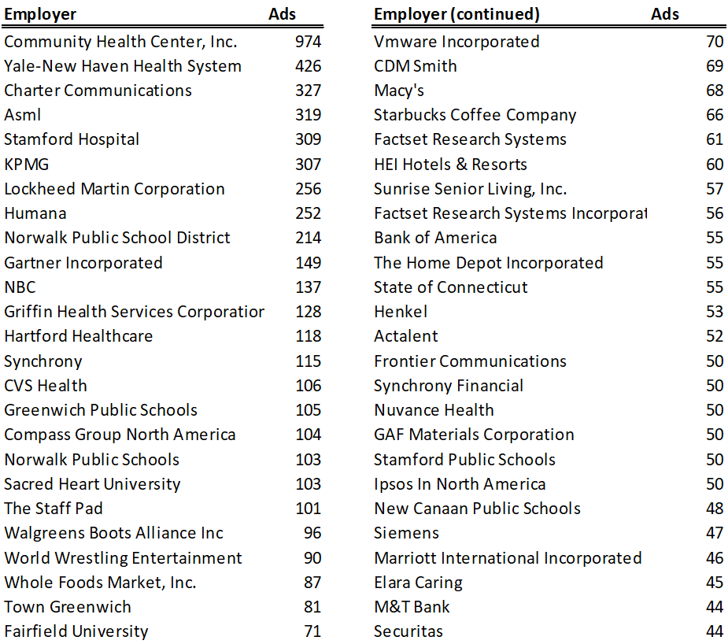
Southwest WDA Employers
with the Most Job Ads
Connecticut Department of Labor – Research Office 200 Folly Brook Blvd. Wethersfield, CT 06109
Help Wanted Online

Slide 41
Southwest WDA Occupations
with the Most Job Ads
Connecticut Department of Labor – Research Office 200 Folly Brook Blvd. Wethersfield, CT 06109
Help Wanted Online

Slide 42
All advertisement data used in this publication is from the Conference Board’s Help Wanted Online data series.
For more information or data requests, contact Matthew Krzyzek in the Office of Research at the Department of Labor.
Matthew.Krzyzek@ct.gov
For more Connecticut Labor Market Information visit:
www.ctdol.state.ct.us/lmi
https://www.facebook.com/ctlmi
Twitter: @DOL_Research
Connecticut Department of Labor – Research Office 200 Folly Brook Blvd. Wethersfield, CT 06109
Help Wanted Online

